Slide 1
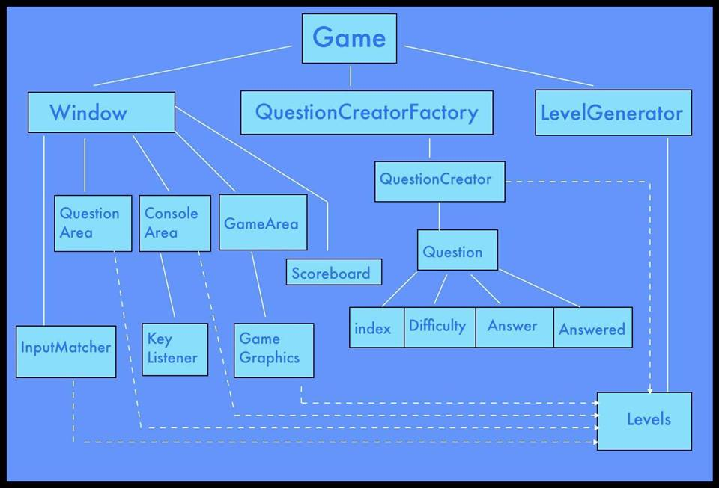

Slide 2
Game Class
Contains the main function
Contains:
  Instance of Window
  Instance of QuestionCreatorFactory
  Instance of LevelGenerator

Slide 3
Window Class
Contains:
  Instance of GameArea
  JLabels for score and player's health
  Question area
  Console area
  Instance of InputMatcher

Slide 4
GameArea Class
Extension of JPanel
Used to display lessons prior to the start of the level
Overridden paint() method allows us to draw graphics based on conditional variables

Slide 5
Scoreboard and Player Health
JLabels that are overlaid on top of the GameArea
Displays the integer values of Score and Health remaining in real-time

Slide 6
Question Area
Comprised of a JTextArea contained within a JScrollArea
Like names suggest, they allow us to display text and scroll
Used to display the questions that the player is to answer

Slide 7
Console Area
Also a JTextArea within a JScrollArea
This JTextArea is set to editable
Contains a KeyListener that reads keystrokes and sends input to the InputMatcher upon “Enter” key being hit

Slide 8
Graphics
All graphics (enemies, player, lesson image, etc.) all implement the Sprite interface
The Sprite interface demands getters/setters for:
  a BufferedImage
  an int representing X-coordinate value of the object
  an int representing Y-coordinate value of the object

Slide 9
Question Interface
Has the following method signatures:
  public boolean isAnswered()
  public void setAnswered()
  public String getAnswer()
  public int getIndex()
  public void setIndex(int index)
  public int getDifficulty()
  an override for the default toString()

Slide 10
QuestionCreator Class
Responsible for pulling a question from XML database of questions
Able to pull questions randomly: wholly random, by difficulty value or by question type

Slide 11
Level Class
Each instance of Level contains a reference to:
  the Question area
  the GameArea
  the QuestionCreator for the level
  the appropriate Lesson graphical object
  the InputMatcher
  Also has an integer variable to limit how many questions spawn during the level

